Slide 1


GROUP 159
Matthew Nicholas Lengkey
Mohan Krishna Reddy Nallamilli
Riya Sanker
An analysis of how identity is being verified and authenticated in Telecommunications in the Nordics

Slide 2
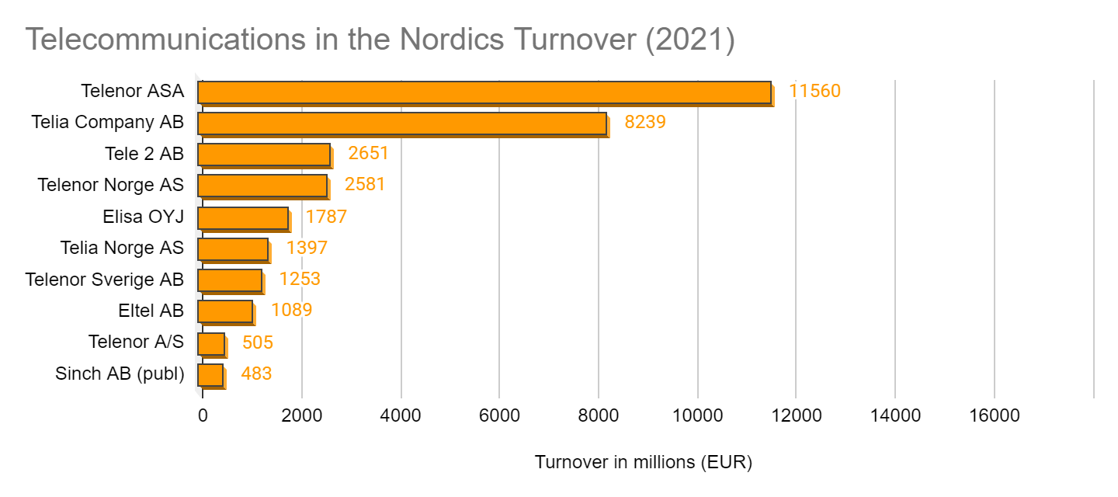

Slide 3
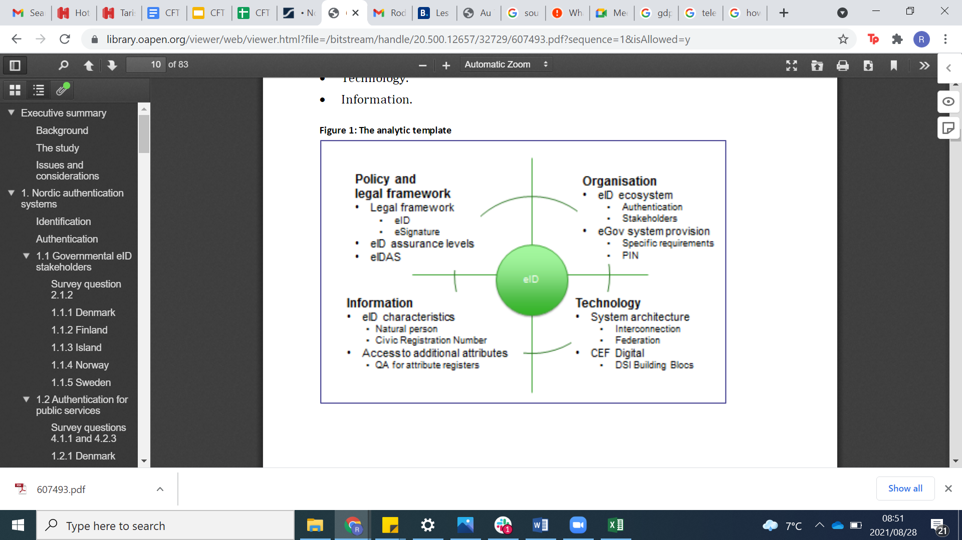
NORDIC DIGITAL IDENTIFICATION
Notes:
Library.oapen.org. 2021. PDF.js viewer. [online] Available at: <https://library.oapen.org/viewer/web/viewer.html?file=/bitstream/handle/20.500.12657/32729/607493.pdf?sequence=1&isAllowed=y> [Accessed 26 August 2021].

Slide 4
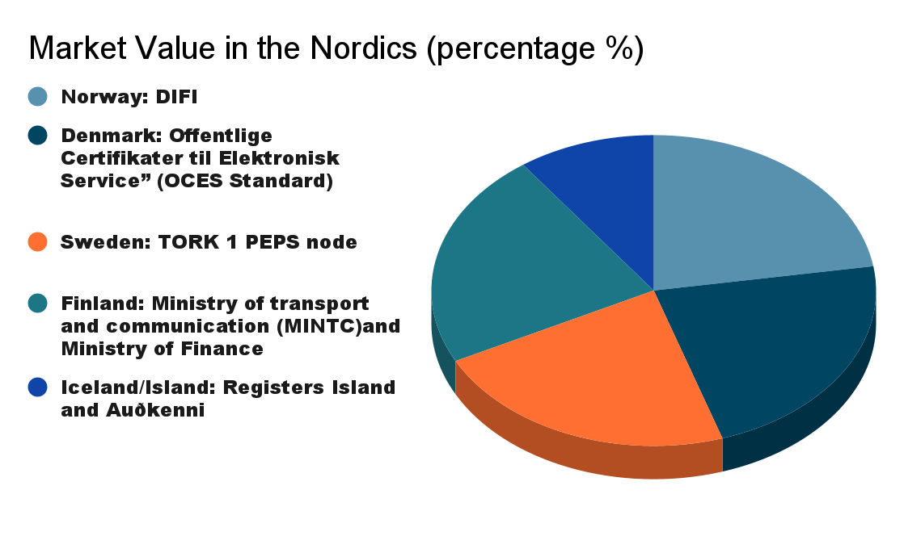
10%
22.5%
22.5%
22.5%
22.5%
Notes:
The above pie chart, represents the market share of the Nordic digital identification systems and their regulatory bodies. It is important to notice that Iceland/Island holds a fairly less percentage of the market, as their systems are not as developed. The main system is simply using a password and text-message verification.

Slide 5
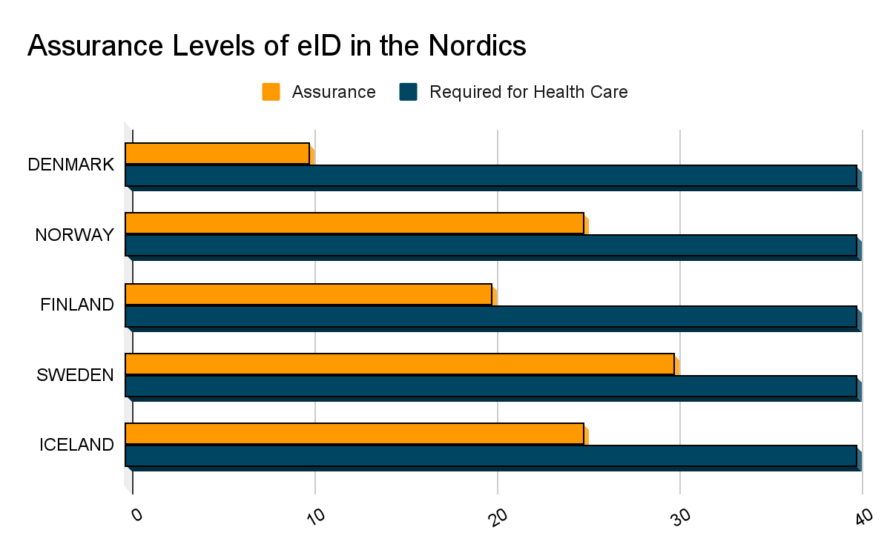
10= Low
20= Moderate
30= Substantial
40= High

Slide 6
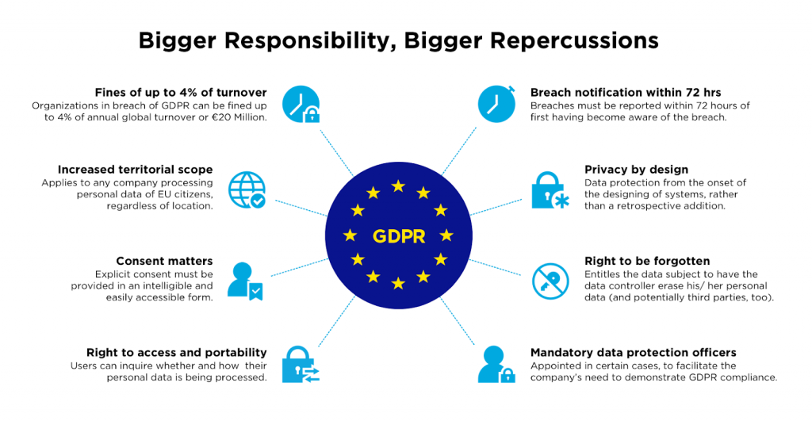
Notes:
General Data Protection Regulation.

Slide 7
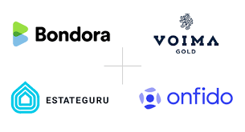
OPPORTUNITY
Onfido has recently entered the Nordics, the demand for digitalization is growing in every industry.
This creates and opens a new competitive market for Onfido to dominate

Slide 8
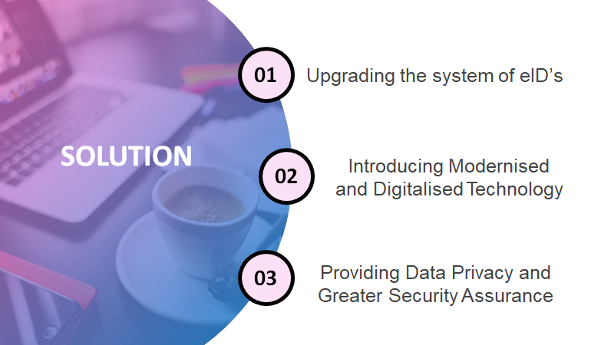

Slide 9
JUSTIFICATION
COVID-19
The worldwide pandemic has created a high demand for contactless transactions, as consumer behaviour is tending towards these online platforms.
Climate Change
Many businesses are seeking green initiatives as their CSR projects in order to protect the future of their consumers.
Trust and Inclusion
Transparency assists in supporting a secure database and higher assurance for all customers, and promotes a more connected international community.

Slide 10
